Slide 1


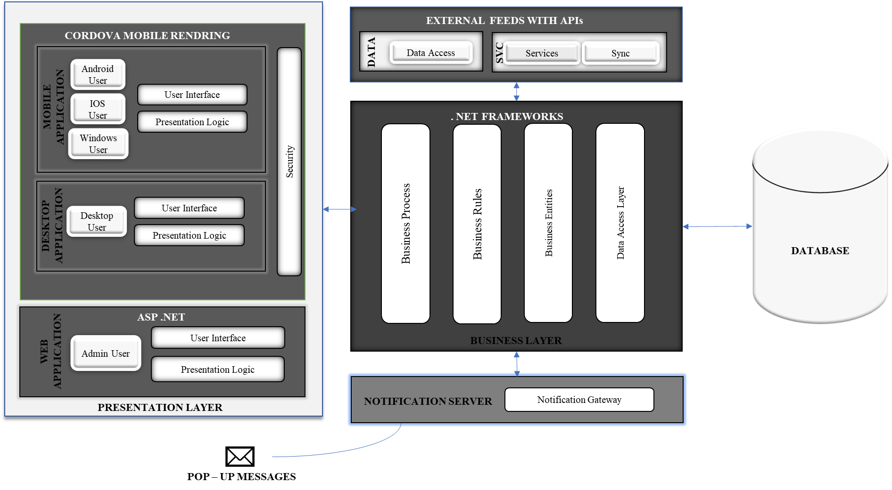
SBSC RFP RESPONSE – PROPOSED SOLUTION HIGH LEVEL ARCHITECTURE
LOGICAL ARCHITECTURE
SBSC Consulting Services – RFP Response - Confidential

Slide 2
SBSC RFP RESPONSE – TECHNOLOGY REQUIREMENT (In – House Hosting)
HARDWARE REQUIREMENTS
SOFTWARE REQUIREMENTS
Server Name | RAM | Hard Disk | Processor
Database Server | 32 GB | 500 GB | 2.4 GHz Octa core/ Xeon 3.46
Application Server | 16 GB | 250 GB | 2 GHz Quad core / Xeon 2.13
Backup Server | 16 GB | 1 TB | 2 GHz Quad core / Xeon 2.13
Physical Firewall
Software
.NET Framework 4.6 (which include compilers, editors, and debuggers)
IDEs, such as Microsoft Visual Studio
Window Server 2012
SQL Management Studio 2017
TECHNOLOGY PLATFORMS USED
Platform | Technology | Overview
Web browser – presentation to Admins | HTML5, Css3, Angular | Google Chrome, Microsoft Edge, IE 9 and above, Opera, Mozilla, Safari, smart mobile devices and tablets
Web Application Framework | .Net Web Api 2 | Web application business logic and workflow area and Data Access Layers
Database | MS SQL SERVER 2017
NETWORK REQUIREMENT
The system requires public internet access to connect to application and database server. However we can also establish a link with any existing network currently in place at Unilever. Please note that as users increase on the platform, the requirements above are subject to change.
SBSC Consulting Services – RFP Response - Confidential

Slide 3
SBSC RFP RESPONSE – HOSTING PLATFORM COMPARISIM
IN - HOUSE HOSTING
PROS | CONS
Gives you physical control over your backup. | Requires a capital investment in hardware and infrastructure.
Keeps critical data in-house. No third party has access to your information. | Needs space in your office for a rack or server room/closet, in addition to dedicated IT support.
No need to rely on an Internet connection for access to data. | May be more susceptible to data loss during disaster situations due to its in-house location. How often you take the data offsite will reflect how much data you’ll lose in an emergency.
Can be more cost-effective for small to mid-sized companies. | No uptime or recovery time guarantees.
CLOUD HOSTING
PROS | CONS
No need for onsite hardware or capital expenses. Well-suited to smaller companies that may outgrow storage too quickly. | The costs of the data recovery could outweigh the benefits for companies that are not as dependent on uptime and instant recovery.
Storage can be added as needed. Solutions are often on-demand, so you only pay for what you need. | Every organization will have a limit to data that can be stored in the cloud due to storage availability and cost.
Backup and restore can be initiated from anywhere, using any computer, tablet, or smartphone. | If the Internet goes down on your side or on your cloud provider’s side, you won’t have access to any of your information.
Data can be backed up in the cloud as regularly as 15-minute intervals, minimizing data losses in disaster situations. Small data set recovery time is improved. | Full data recovery could prove very time-consuming and impactful on systems.
SBSC Consulting Services – RFP Response - Confidential

